Slide 1
Exploring the Role of AI in Engineering
Session Organizers:
Nader Jalili, Southern Methodist University, Session Lead
Aaron Bobick, Washington University in St. Louis
Amit Shukla, Seattle University
Session 1: AI in Higher Education: Navigating Impact and Future Trends (9:15 – 10:30 am)
How AI is going to revolutionize education through personalized learning pathways and intelligent tutoring systems?
Ways AI enhances administrative processes.
Session 2: Navigating the AI Landscape: Bridging Academic Research and Industry Expectations (11:00 – 12:15 pm)
The dynamic interplay between academic research in AI and the evolving expectations of the industry.

Slide 2
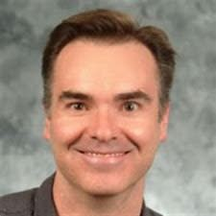
Navigating the AI Landscape: Bridging Academic Research and Industry Expectations
George Small
Chief Technology Officer, Moog Inc.
Moog is focusing on the combination of technology development and business development to drive new growth opportunities.
George has been with Moog Inc. for 28 years. He has held numerous engineering leadership positions within aerospace and industrial design and development, including Chief Engineer of Flight Controls at Moog, as well as 5 years as a Principal Engineer at Moog.
In his role as CTO at Moog since 2017, George currently leads efforts to develop new growth opportunities within electrification, robotics and autonomy, Industry 4.0, and Artificial Intelligence across Moog’s operating groups.

Slide 3
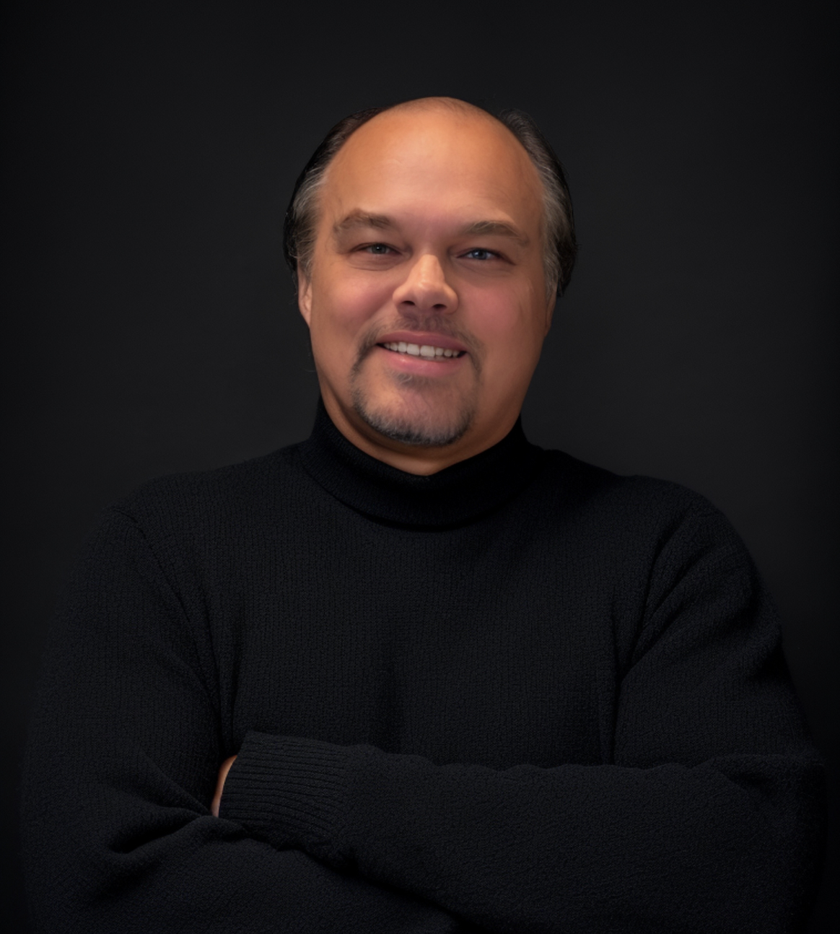
Navigating the AI Landscape: Bridging Academic Research and Industry Expectations
Dave Copps
CEO, Worlds
Dave is known internationally as a technologist and visionary on the role that deep tech will play in transforming markets and the world.
Dave has founded, launched, and sold two Al companies that have placed machine learning and artificial intelligence in thousands of companies worldwide. He was recently awarded EY's Entrepreneur of the Year for the Central Plains Region, and while serving as CEO of his previous company, Brainspace, he was recognized as Emerging Company CEO of the Year.
Dave currently serves as CEO of Worlds, where he leads the company in delivering their WorldsAI platform bringing AI-based automation into the physical operations of the world's largest industrial companies.
He received his BA from the University of North Texas. Dave is an invited member of the Aspen Institute's Roundtable on Al, the XPRIZE Visioneering Board, a Capital Factory Partner, and a frequent speaker at conferences, universities, and incubators worldwide.

Slide 4
Navigating the AI Landscape
George Small
CTO Moog Inc.
ASEE Engineering Deans Institute
San Diego 15 Apr 2024

Slide 5
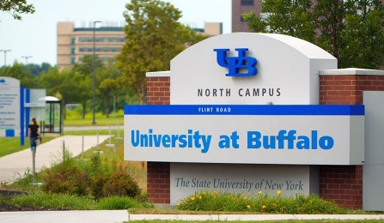
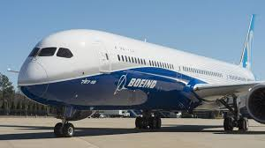
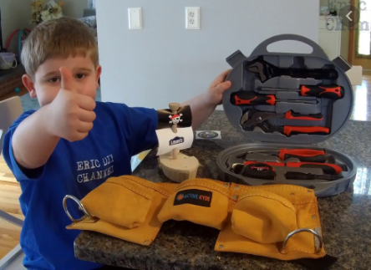
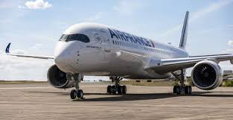
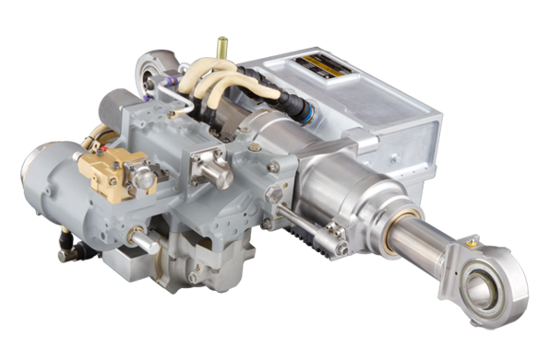
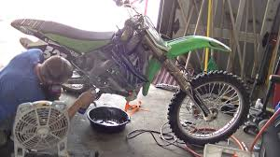
George Small: Introduction
Grew up in the Buffalo, New York area
Graduated from University at Buffalo in 1987 as a Mechanical Engineer
Started at Moog in 1996 as a Design Engineer in Flight Controls
CTO since 2017

Slide 6
Moog Overview

Slide 7
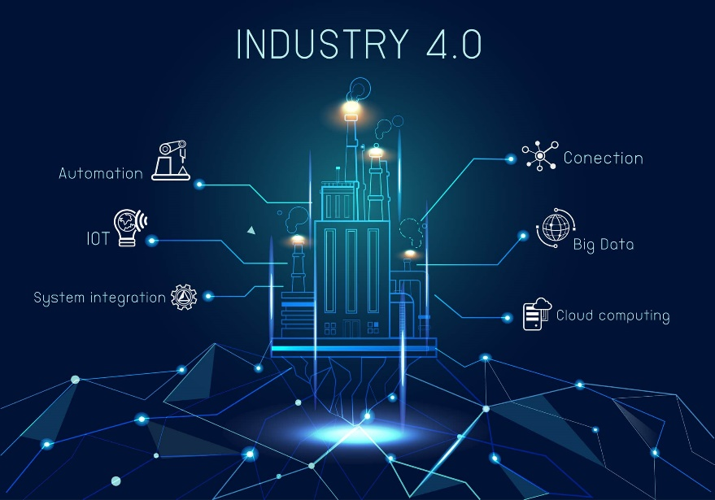
AI: Starts with Digital Transformation
Mega Trends:
Availability of ubiquitous compute, storage
Connectivity all the way to the mobile edge
Advanced algorithms and Artificial Intelligence
To Leverage, this Needs:
A ‘digital first’ mindset in problem solving
May need to adapt the way we and our partners do our work to harness
Collaborative, ecosystem approach
Smart Connected Products
Digital Strategy has 2 Major Legs Leveraging a Common Digital Platform
Create New Value
Improve Efficiency
Smart Connected Factories
Notes:
AI Consortium meets bi-weekly
AI CoE has been taking a 2 phased approach: Phase 1 Startup and Phase 2 Scale
Proof of Value from Phase 1 is expected in Mid-November

Slide 8
AI Fireside Chat: Talking Points
AI: Starts with Digital Transformation
Data driven, Needs a ‘digital first’ mindset in problem solving
AI is a general-purpose, accessible and scalable technology
Broadly available (in theory). People are bringing their own experiences and expectations from home to their employers (and their schools)
Essential to have uniform guidelines and to provide training on acceptable and responsible use of AI technology
Moog Internal AI Task Force
AI is a tool to make our people more productive, not a replacement for them
Knowledgeable Human Oversight Required!
Tools divided into:
Tools everyone will have (e.g., Copilot for Microsoft 365)
Tools only you will have (your differentiation)

Slide 9
AI Fireside Chat: Talking Points (continued)
Nobody knows exactly how the rapidly evolving landscape will evolve
Drives a need for rapid experimentation and iterative design
Need to find and prove where the value resides
Target highly repetitive task that still require knowledge that can be captured
Proprietary automation tools capable of capturing and codifying organizational know-how
Of larger benefit to less experienced personnel than highly skilled
No area seems unaffected within our company
First waves of automation affected our machine shops going back to the 70s
This wave affects front office knowledge workers

Slide 10
AI Fireside Chat: Implications
A greater emphasis on AI and machine learning skills, autonomous systems expertise, and cybersecurity knowledge.
Expect new hires to be aware of AI and embrace digital mindset in their approaches to problem solving.
AI background needed in specific areas
Robotics, perception
Advanced simulation systems
Autonomous systems, drones, UAS, UAV, etc.
Networked systems, Cybersecurity
Supply Chain Optimization
Be aware of and address digital divide
Access and affordability for students

Slide 11
Navigating the AI Landscape: Bridging Academic Research and Industry Expectations
AI Fireside Chat with Dave Copps, CEO of Worlds
The perfect storm has formed for AI (the pieces are in place for an accelerated evolution)
What just happened? (Gen AI)
What will it lead to? Our future with AI.
What it means for jobs and education?

Slide 12
Interactive Discussions and Q/A (Pls. complete the survey)
What is Happening Today? What is Coming? And How Can We Prepare?
The dynamic interplay between academic research in AI and the evolving expectations of the industry.
What it means for jobs and education.
Our future with AI.
Embracing digital mindset and digital divide.

Slide 13
Thank you all for your time and thoughtful inputs!

